Slide 9
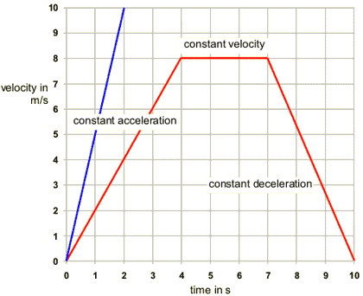
Velocity-Time Graphs
Velocity on y-axis
Time on x-axis

Slide 10
Velocity- Time Graphs

Slide 11
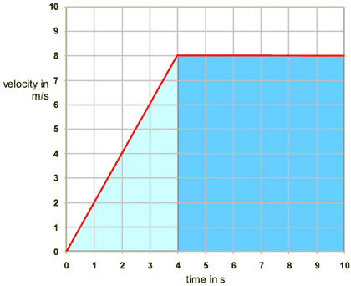
Velocity-Time Graphs
Displacement is the area under the curve.
Slope is acceleration.
Instantaneous Velocity is any point on the line.

Slide 13
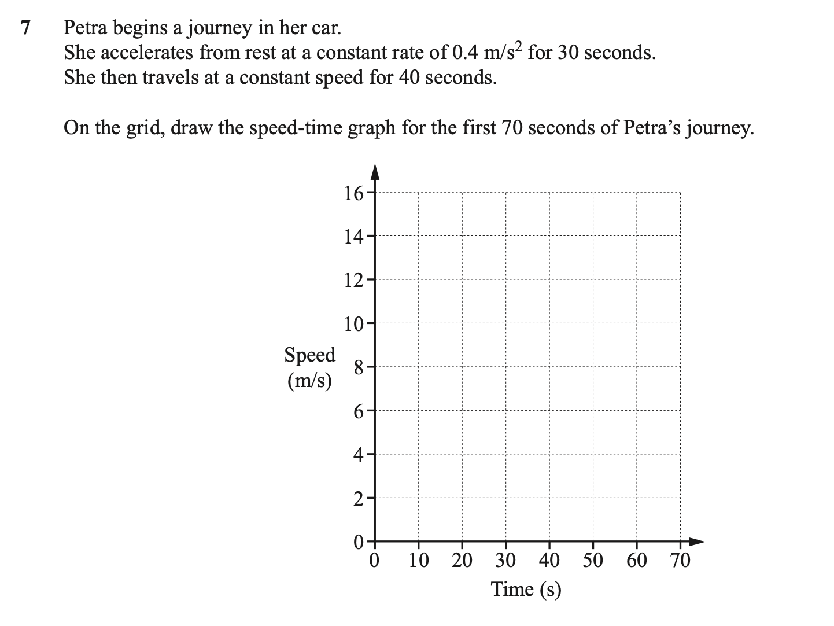

Slide 14
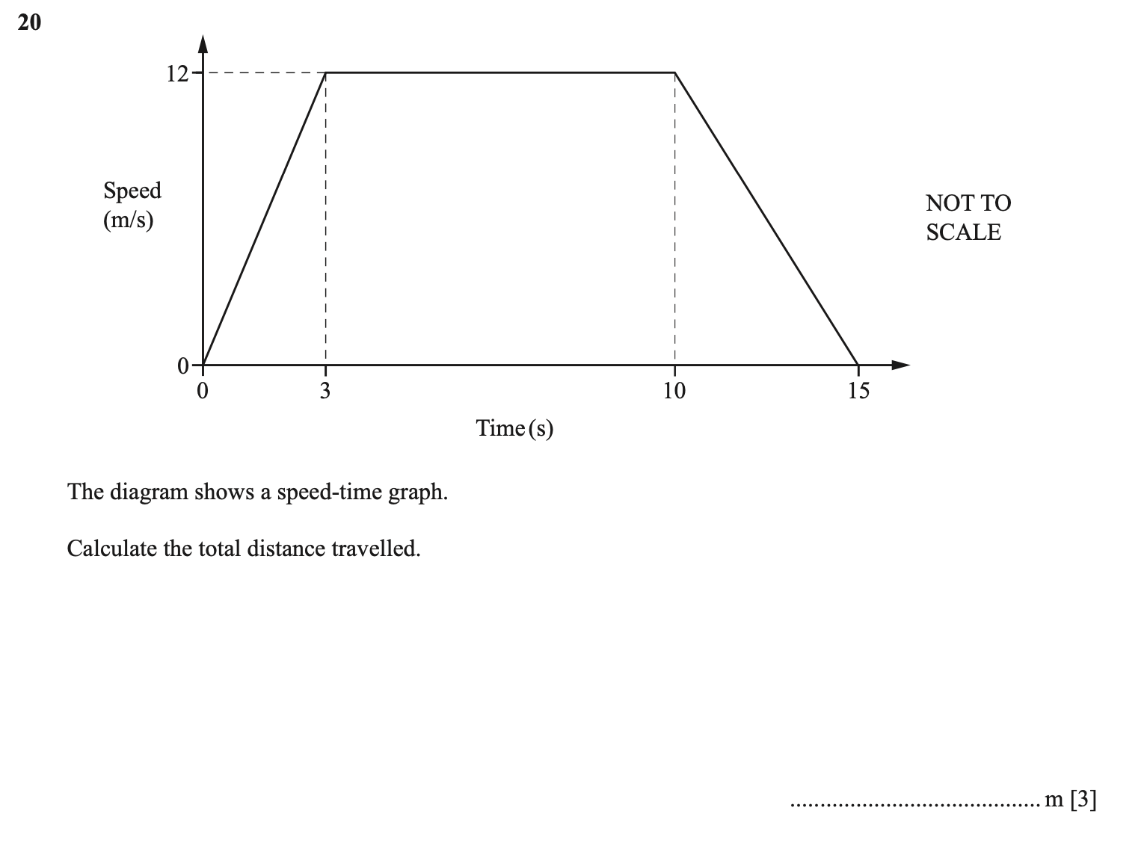

Slide 15
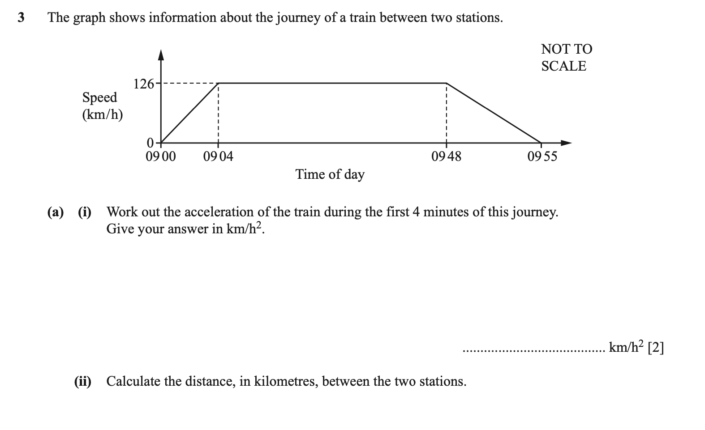

Slide 16
